Slide 1
Designing and Using Normalization Rules
Yoel Kortick. Senior Librarian

Slide 2
Introduction
Creating normalization rules and processes
Using a normalization processes for import profile
Using a normalization processes for batch update

Slide 3
Introduction
Normalization rules are designed to change or update bibliographic metadata at various stages, for example when the record is:
Saved in the metadata editor
Imported via import profile
Imported from external search resource
Edited via the "enhance the record" menu in the metadata editor
Run on a saved set (global update)
Published (exported) visa a general publishing profile

Slide 4
Introduction
The normalization rules are written in a specific syntax allowing the user to create rules to for example
  Add fields
  Delete fields
  Change text
  Change field tags
  Change indicators
These operations may be performed
  Unconditionally
  Conditionally

Slide 5
Introduction
This presentation will not discuss the specific syntax of the normalization rules.
The focus here will be specifically on how the normalization rules are created as well as how and where the rules may be used.
For an extensive list of normalization rule examples see “Normalization Rule Examples” at https://knowledge.exlibrisgroup.com/Alma/Training/Extended_Training/Presentations_and_Documents_-_Rules

Slide 6
Creating normalization rules and processes

Slide 7
Creating normalization rules and processes
The normalization rules are created either
In the metadata editor via menu "File > new > normalization rules"
From the left pane by doing "duplicate" on an existing normalization rule
By copying an existing rule from the community

Slide 8
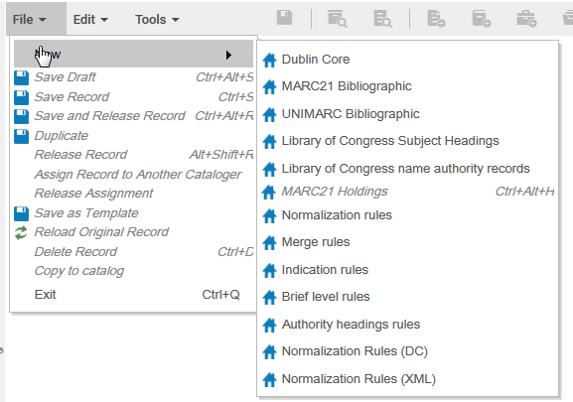
Creating normalization rules and processes
In the metadata editor via menu "File > new > normalization rules"

Slide 9
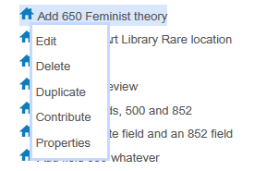
Creating normalization rules and processes
From the left pane by doing "duplicate" on an existing normalization rule

Slide 10
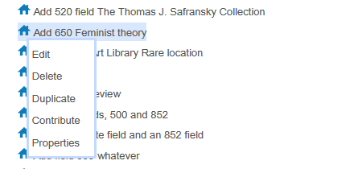
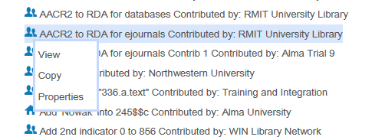
Creating normalization rules and processes
By copying an existing rule from the community
Contribute rule to the community
Copy rule from the community

Slide 11
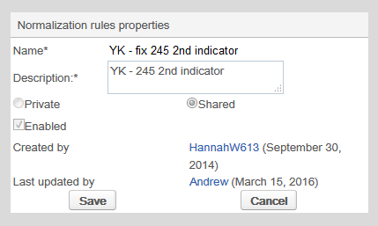
Creating normalization rules and processes
Normalization rule properties
A logical name and description to later know what this rule does
Choose shared if you want other uses to also access this rule
Choose enabled if you want this rule to be active. When still editing and testing you may wish to leave it not enabled

Slide 12
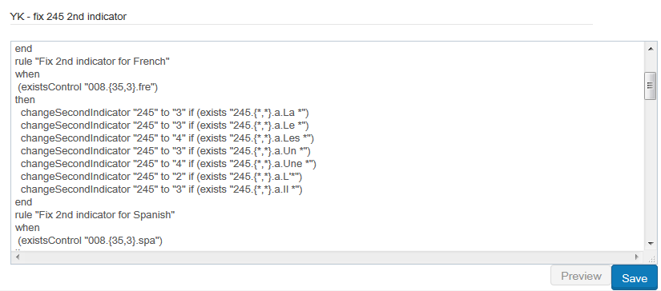
Creating normalization rules and processes
After defining the properties enter (or edit existing) text of the normalization rule and click ‘save’

Slide 13
Creating normalization rules and processes
A normalization rule can be tested as follows:
Open a bibliographic record in edit mode
Switch to split editor mode.
Leave the bibliographic record in the left pane of split window
Focus on the right pane of split window
Select the normalization rule and choose "edit"
Click "Preview" on the rule
See what the rule does to the record

Slide 14
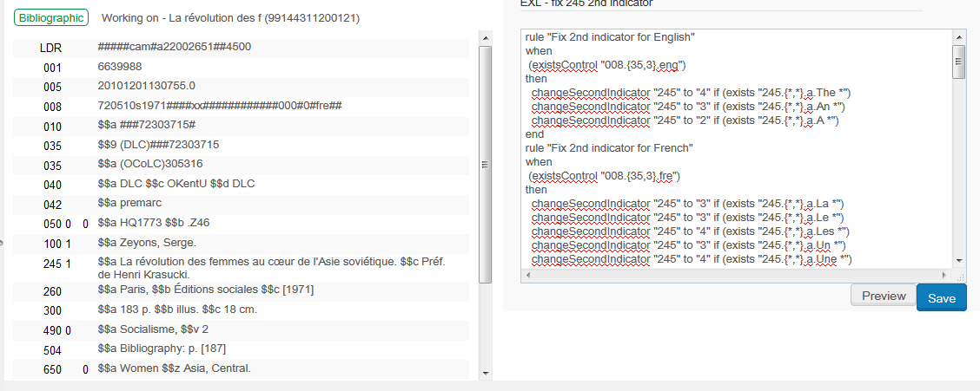
Creating normalization rules and processes
Preview the results of the normalization rule

Slide 15
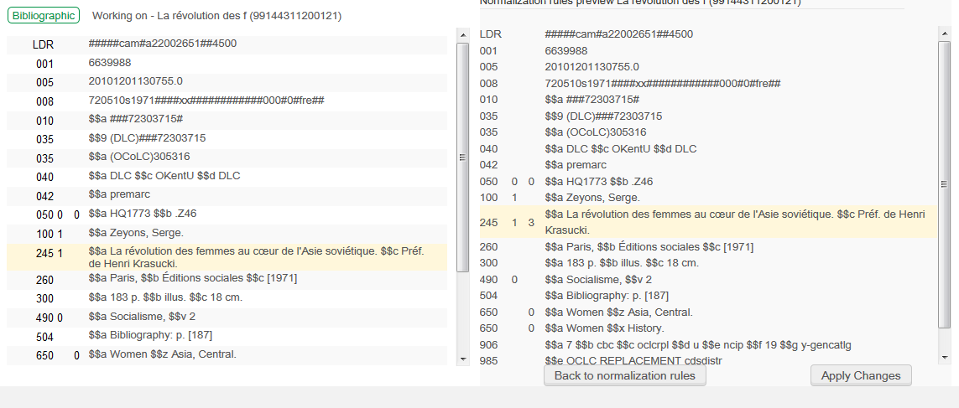
Creating normalization rules and processes
Compare the records and see results
Record on right got a new 245 2nd indicator
Clicking "Apply changes" will update the record
Clicking "Back to normalization rules" will return the user to the rule for additional editing

Slide 16
Creating normalization rules and processes
In order to be able to use the normalization rule in various parts of the system it needs to be added as a process
Each process may include one or more normalization rules.
In this example we will add one normalization rule to a process.
The normalization rule we will add is "EXL – fix 245 2nd indicator"

Slide 17
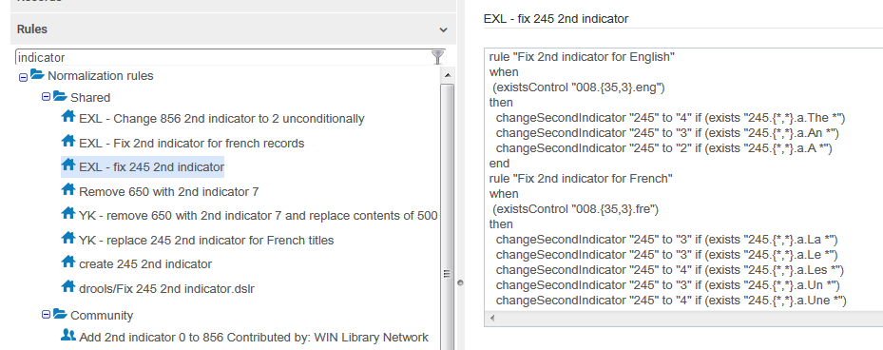
Creating normalization rules and processes
This is the normalization rule we will add.
It first fixes the 245 2nd indicator depending on the language in the 008 and initial string of the field.

Slide 18
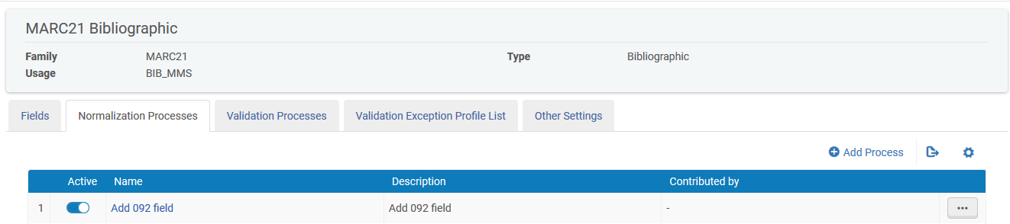
Creating normalization rules and processes
Access the list of normalization processes from the Resource Management Configuration Menu and navigate to: Cataloging > Configuration > Marc 21 Bibliographic > Normalization Processes
To add a new process click "Add Process"

Slide 19
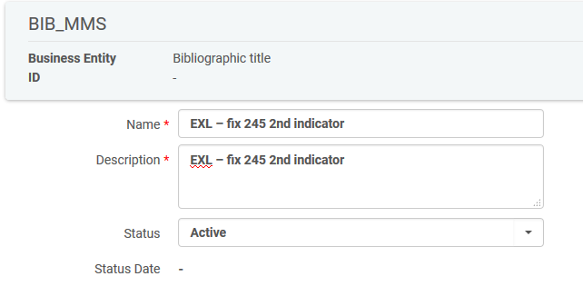
Creating normalization rules and processes
Give the process a name
We are making the process have the same name as the rule which it will use. This is not mandatory but done here for "organizational" purposes.

Slide 20
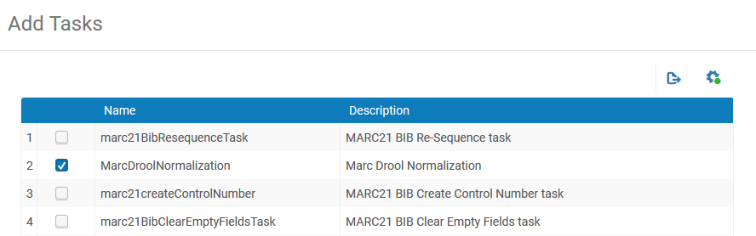
Creating normalization rules and processes
Click “Add Task” and then choose MarcDroolNormalization
This means that it will use a normalization process

Slide 21
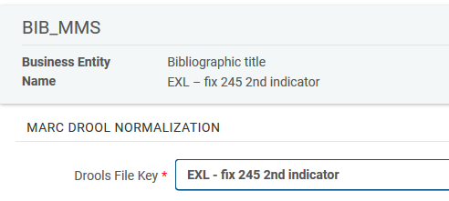
Creating normalization rules and processes
Choose the specific normalization rule.
The normalization rule we will choose is "EXL – fix 245 2nd indicator" which looked at a short time ago

Slide 22
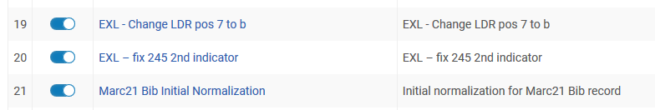
Creating normalization rules and processes
The new normalization process has been added

Slide 23
Using a normalization processes for import profile

Slide 24
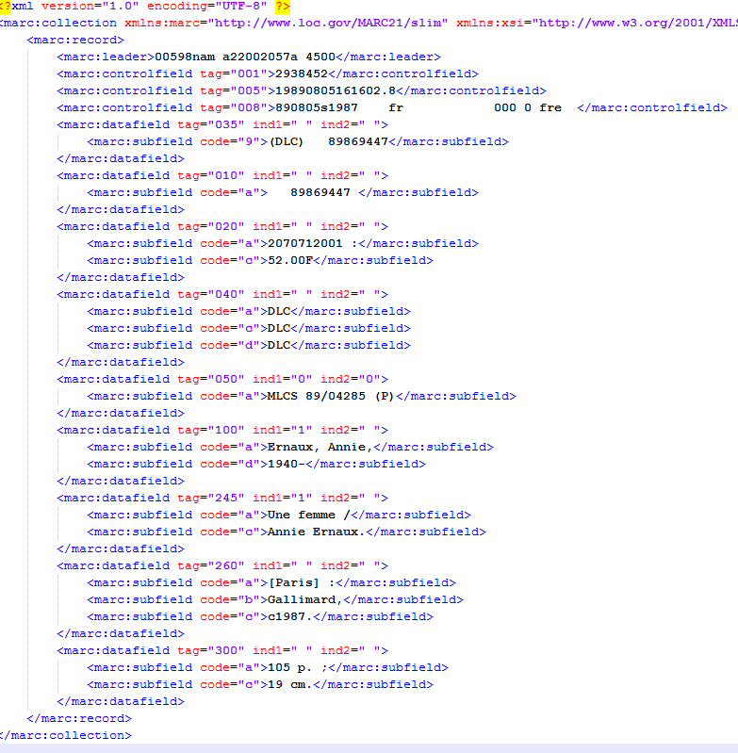
Using a normalization processes for import profile
Language code in 008 is “fre”
245 2nd indicator is empty.
Text starts with “Une”

Slide 25
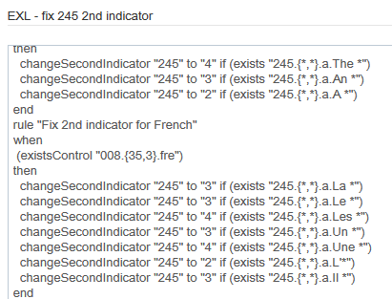
Using a normalization processes for import profile
Our normalization rule “EXL – fix 245 2nd indicator” which is in normalization process “EXL – fix 245 2nd indicator” should fix this (should change it and make 2nd indicator 4):

Slide 26
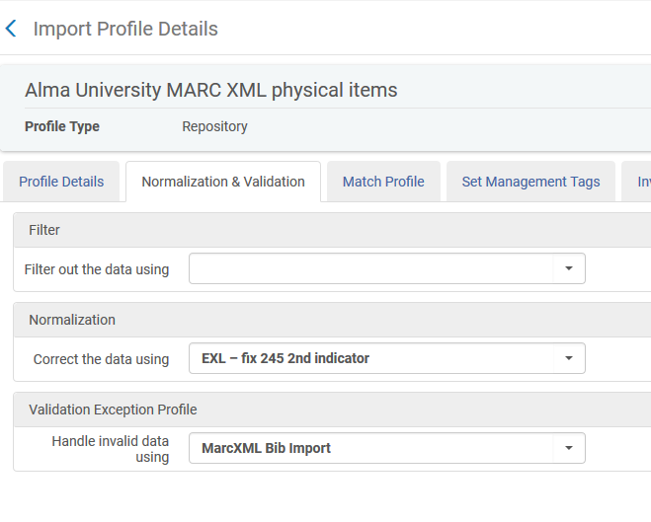
Using a normalization processes for import profile
The import profile will use the normalization process “EXL – fix 245 2nd indicator”

Slide 27
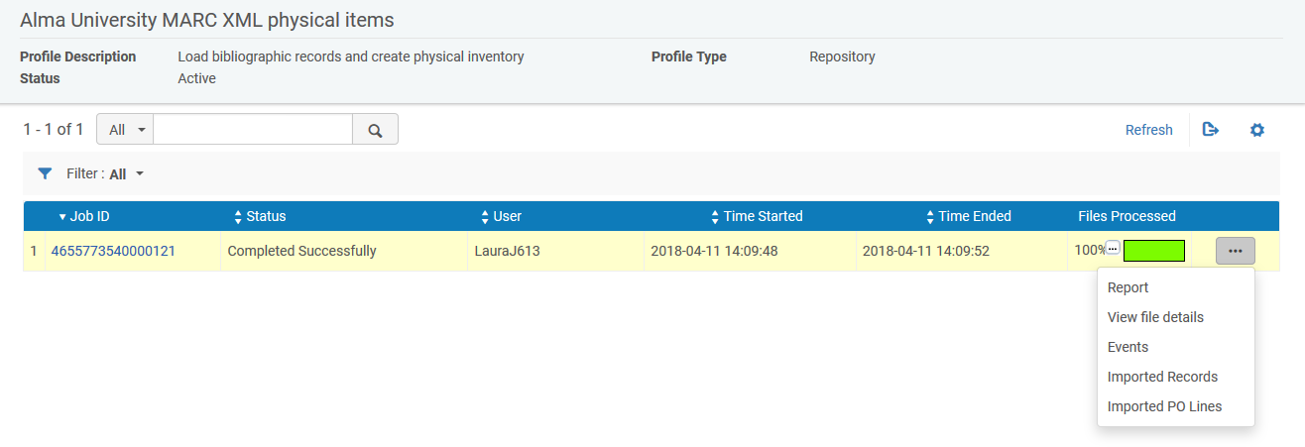
Using a normalization processes for import profile
The record has been imported and we will view it

Slide 28
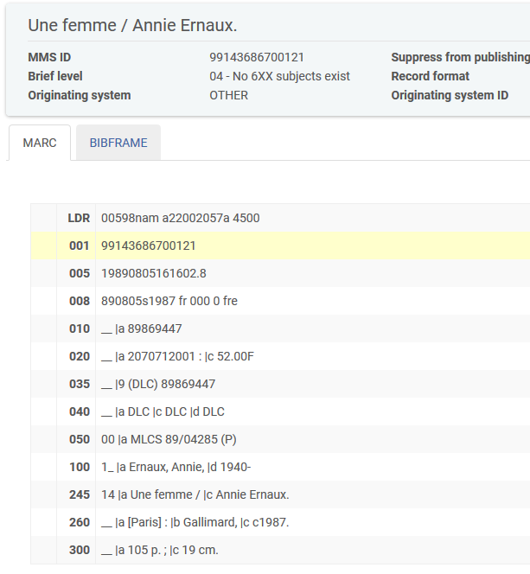
Using a normalization processes for import profile
The record was changed (2nd indicator was added) as per the normalization rule

Slide 29
Using a normalization processes for batch update

Slide 30
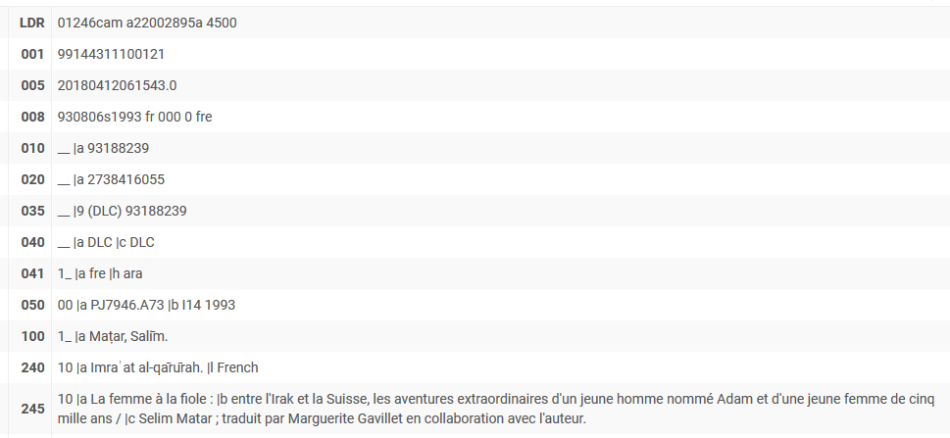
Using a normalization processes for batch update
We will now perform batch update on a set using the same normalization process.
Title "La femme à la fiole" is an example of a record which has a bad 245 2nd indicator
245 2nd indicator should be 3

Slide 31
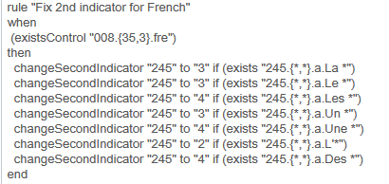
Using a normalization processes for batch update
Title "La femme à la fiole" begins with ‘La ‘ and has 008 pos 35-37 “fre”.
Therefore 245 2nd indicator should be three

Slide 32
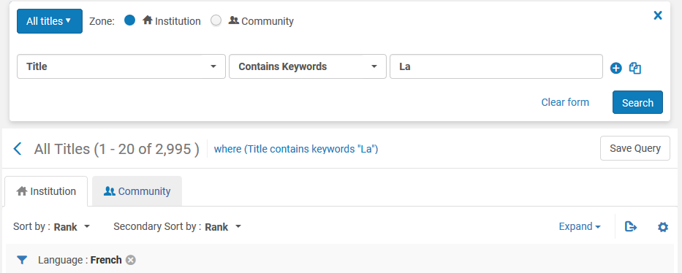
Using a normalization processes for batch update
Title "La femme à la fiole" is part of a set we are creating called "need to check 245 2nd indicator“
We create the set by retrieving all records with “la” in the title and then faceting by language French and clicking ‘Save Query”

Slide 33
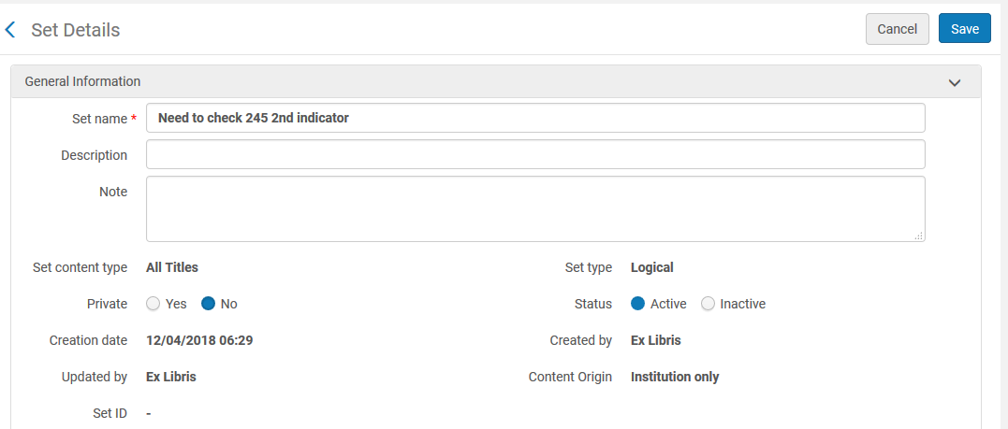
Using a normalization processes for batch update
The set is called "Need to check 245 2nd indicator"

Slide 34
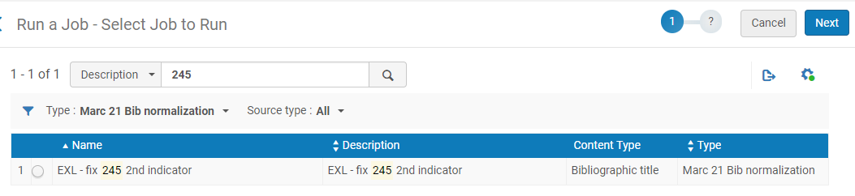
Using a normalization processes for batch update
Now we will run the process "EXL – fix 245 2nd indicator" on the set "Need to check 245 2nd indicator"
We will go to "Run a job" and filter by Marc 21 Bib normalization and then choose the normalization process.

Slide 35
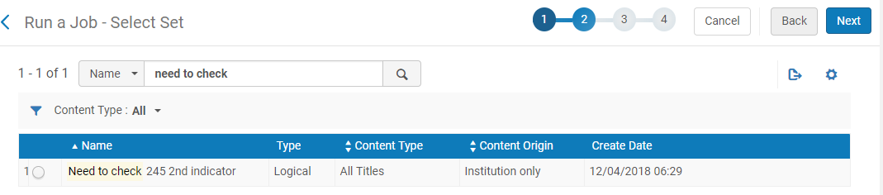
Using a normalization processes for batch update
Search for the set and select it

Slide 36
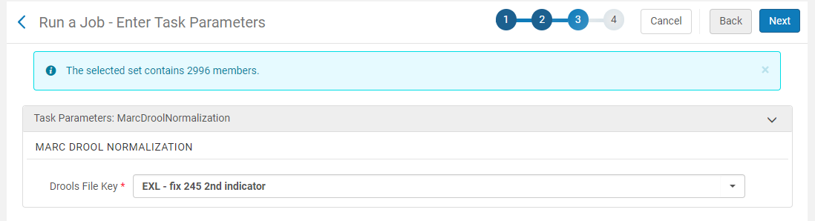
Using a normalization processes for batch update
Leave the default normalization rule from the process

Slide 37
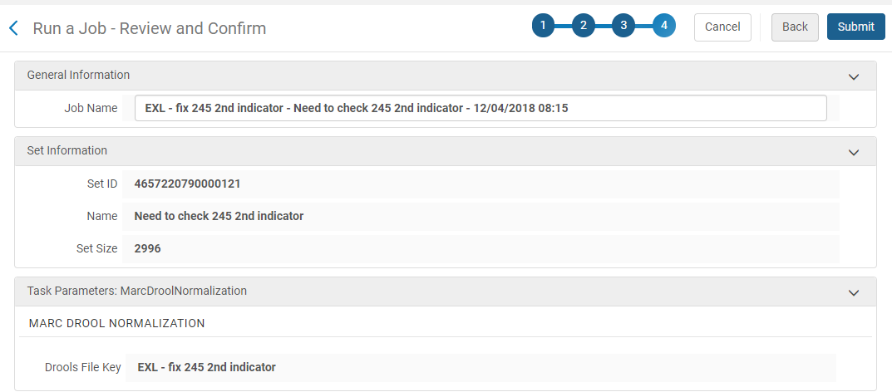
Using a normalization processes for batch update
Submit the job

Slide 38
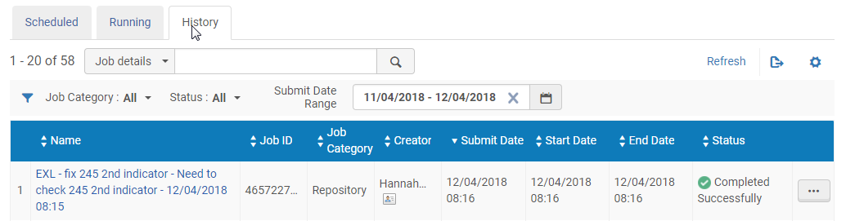
Using a normalization processes for batch update
The job completes successfully

Slide 39
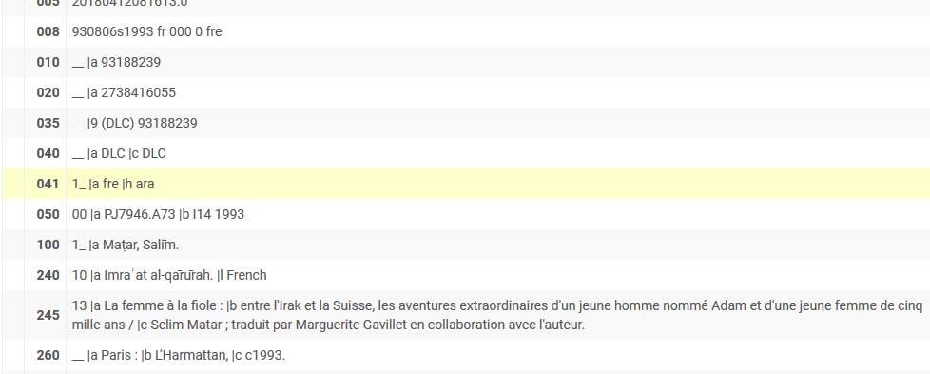
Using a normalization processes for batch update
The record got updated
245 2nd indicator changed to 3

Slide 40
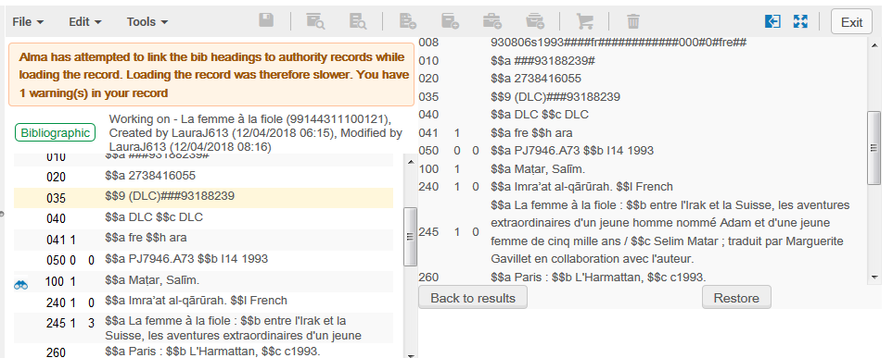
Using a normalization processes for batch update
In the metadata editor ‘Tools > view versions’ you can see the previous version and compare

Slide 41
Yoel.Kortick@exlibrisgroup.com

